Slide 1
Insurance claim
Excel project-3

Slide 2
1. A . Identify the categorical and continuous variables
Categorical variable
1.Sex
2.Smoker
3.Region
4.Continous variable
5.Age
6.Bmi
7.Children
8.charges

Slide 3
1.b. Histograms and box plot with correlation
Approach used: By selecting age in the given insurance data -> creating histogram analysis using data analysis tab in menu with bin frequency & chart as well.
And same approach used for all other data which is present in the insurance data for BMI, Children & charges .
Output:

Slide 4
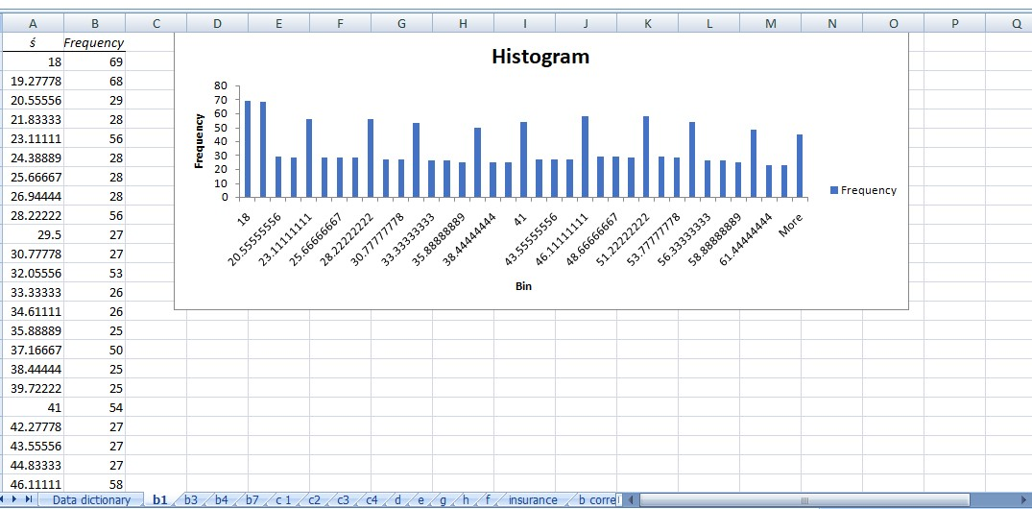

Slide 5
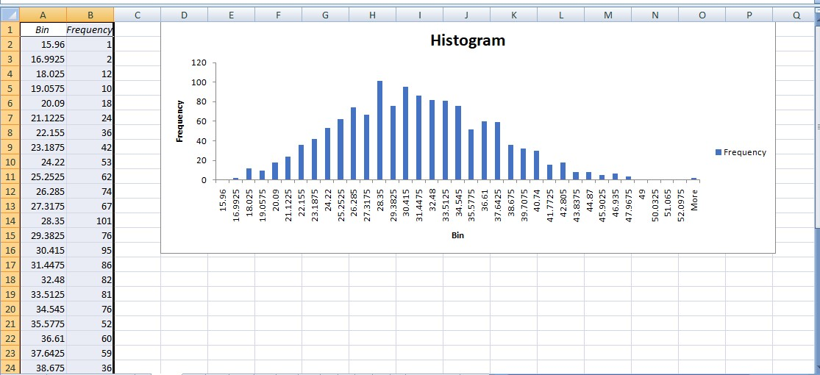

Slide 6
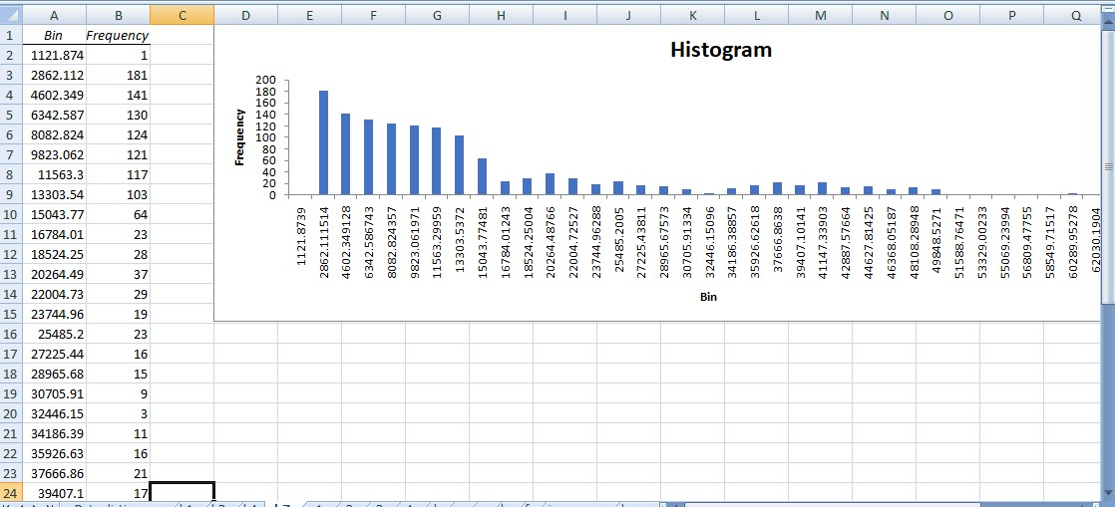

Slide 7
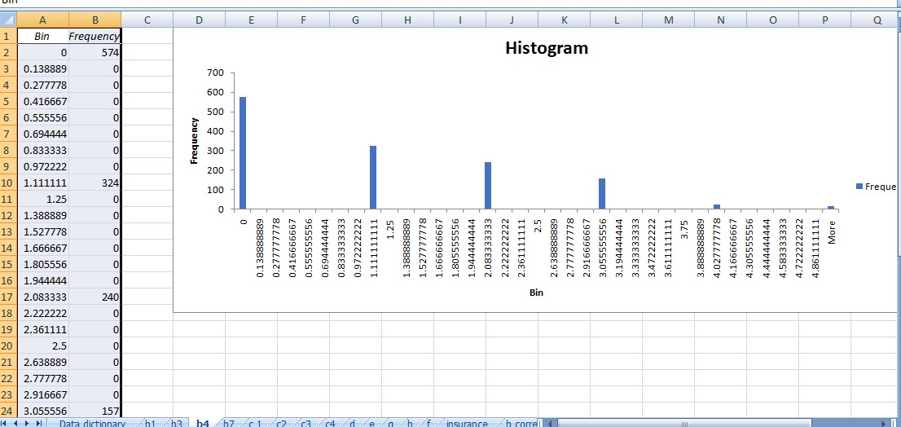

Slide 8
Make relevant Pivot tables and charts for: Male/Female ratio and share information on which gender has more smokers.
Approach used: created the pivot table for the entire data and selecting the Male/Female got dragged into the values and filters to get the count of the smokers from male and female and also created the pivot chart as well.
So approach used for below mentioned :
ii. Charges vs Age
iii. Charges vs BMI
iv. Charges for Smokers vs Non-smokers
Output:

Slide 9
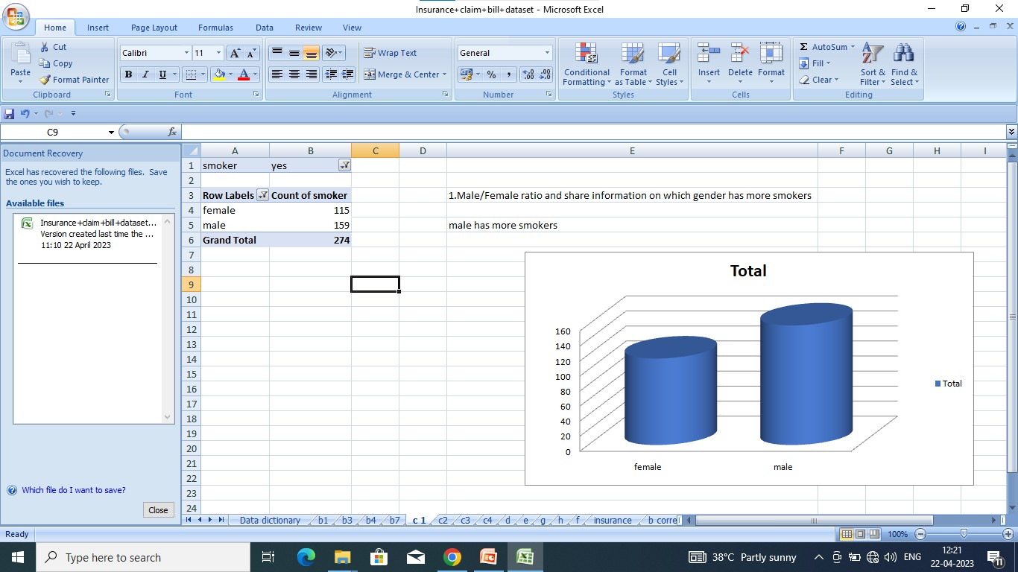

Slide 10
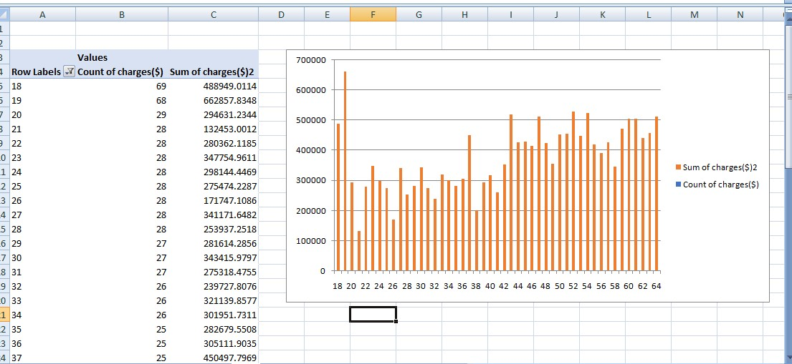

Slide 11
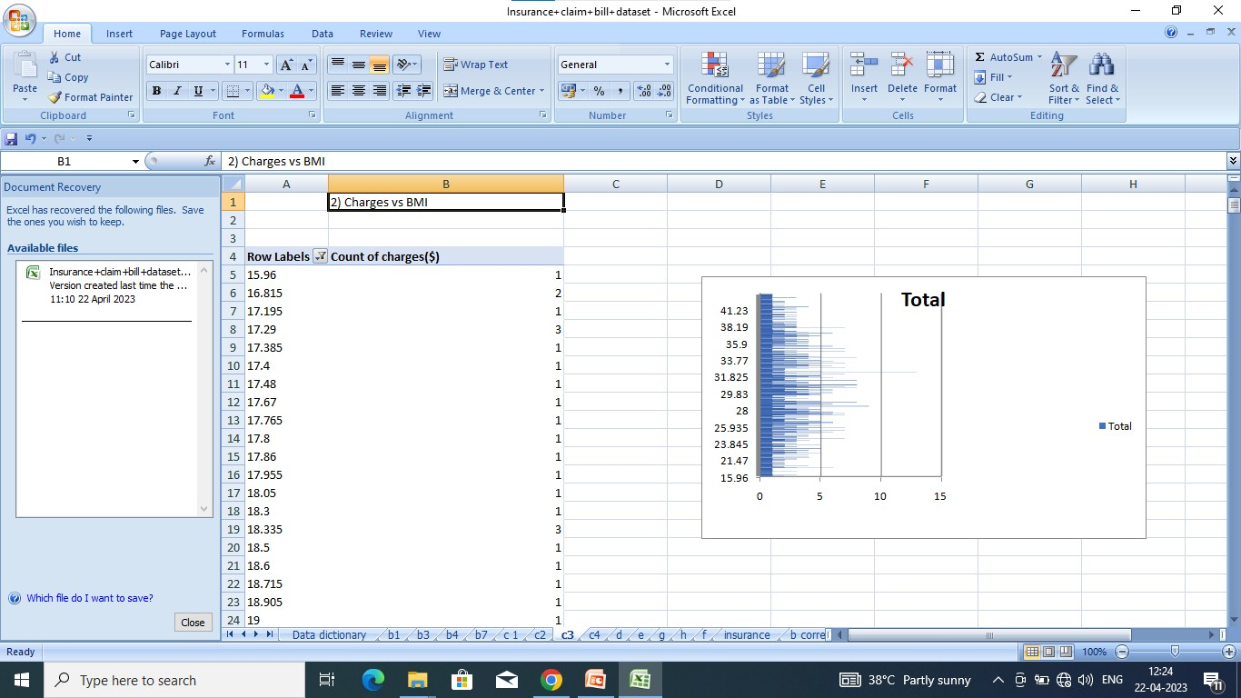

Slide 12
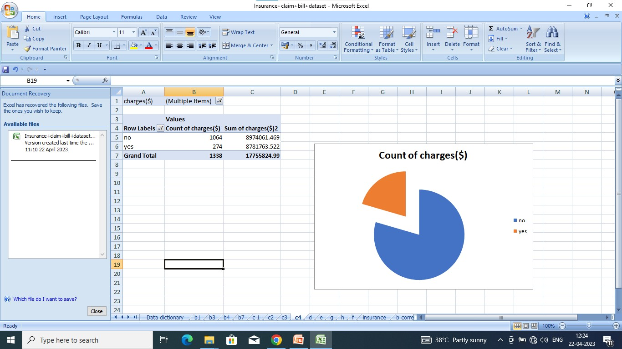

Slide 13
D. Region-wise smokers vs Non-smokers analysis with one or more pivot table and charts
Approach used: created the pivot table for the entire data and selecting Region-wise smokers vs Non-smokers and dragged into the values and filters field to get the required output and also created the pivot chart as well.
Output:

Slide 14
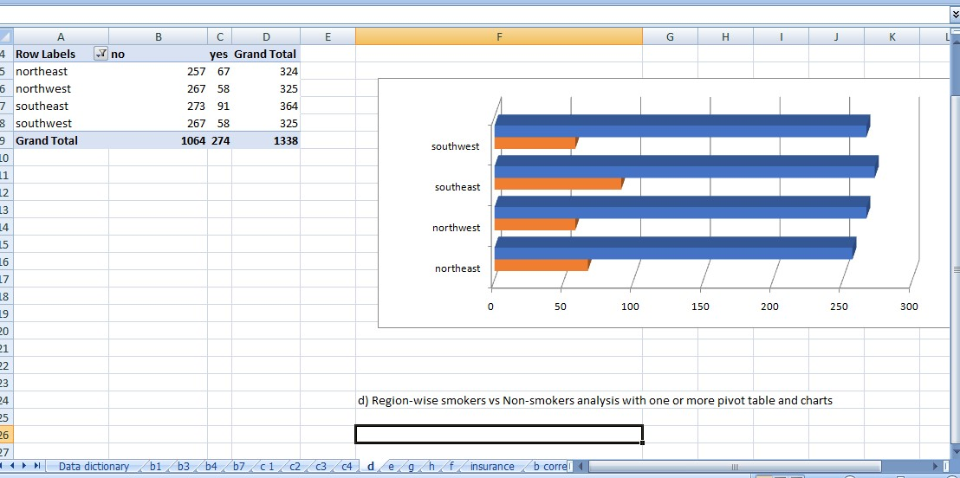

Slide 15
e.Region-wise charges for smokers vs non-smokers
Approach used: created the pivot table for the entire data Region ,smokers , dragged into the values and filters field to get the required output
Output:

Slide 16
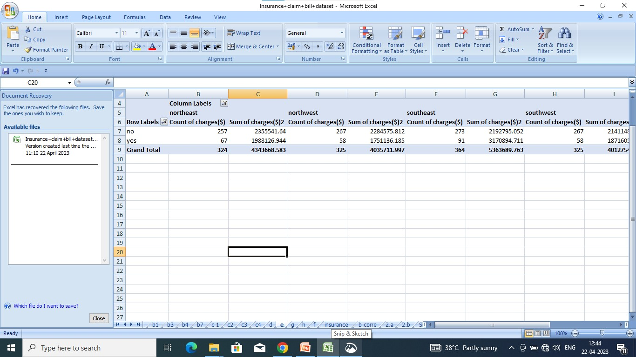

Slide 17
charges got something to do with the number of dependents
Approach used: created the pivot table for the entire data childrens and charges , dragged into the values and filters field to get the result to display total values of charges and childrens count as well
Output:

Slide 18
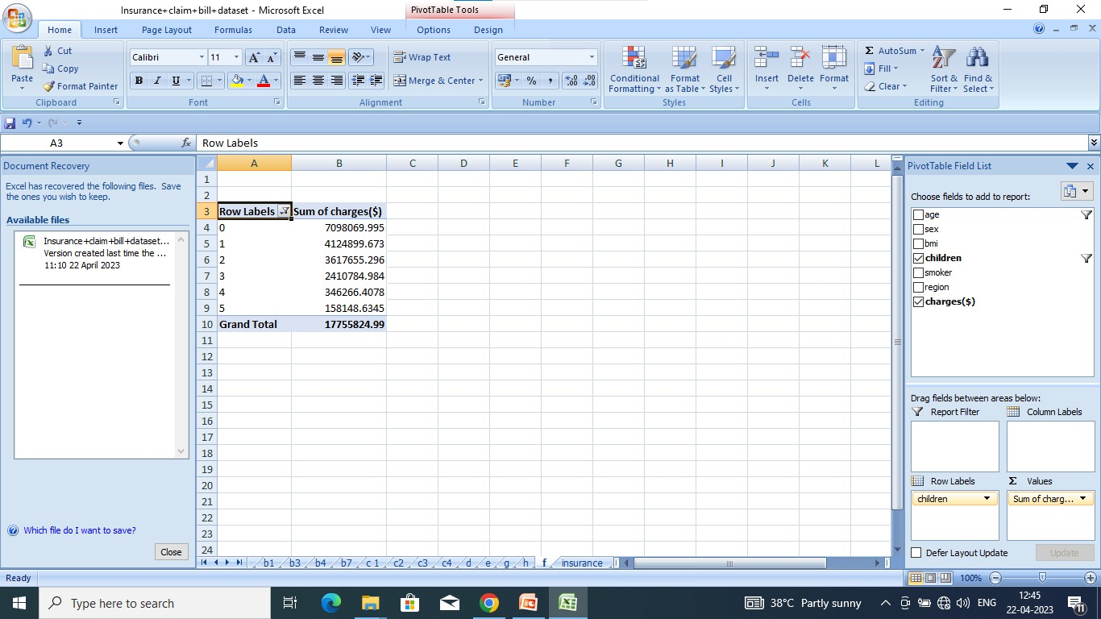

Slide 19
g.Do a similar dependants-charges analysis, Region-wise
Approach used: created the pivot table for the entire data childrens smoker,region & charges , dragged into the values and filters field to get the result to display total values of charges and childrens count.
Output:

Slide 20
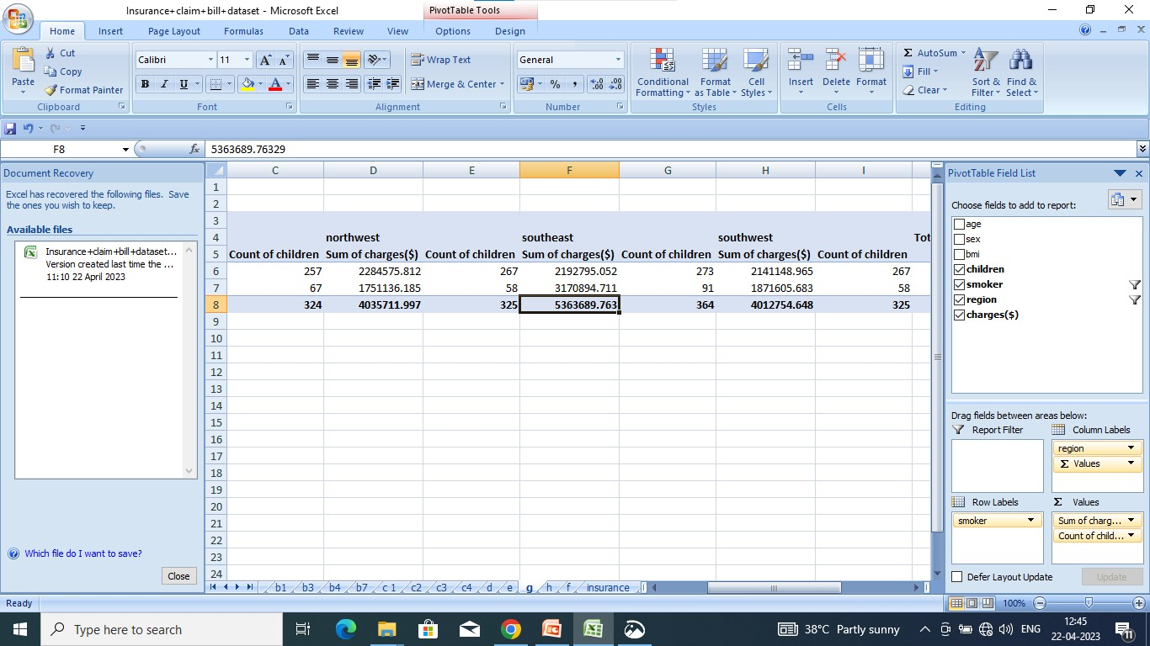

Slide 21
h.Creating pivot table and chart by own:
Approach used: created the pivot table for the entire data sex, smoker , region dragged into the values and filters field to get the result to display expected result with created pivot chart using the pivot table .
Output:

Slide 22
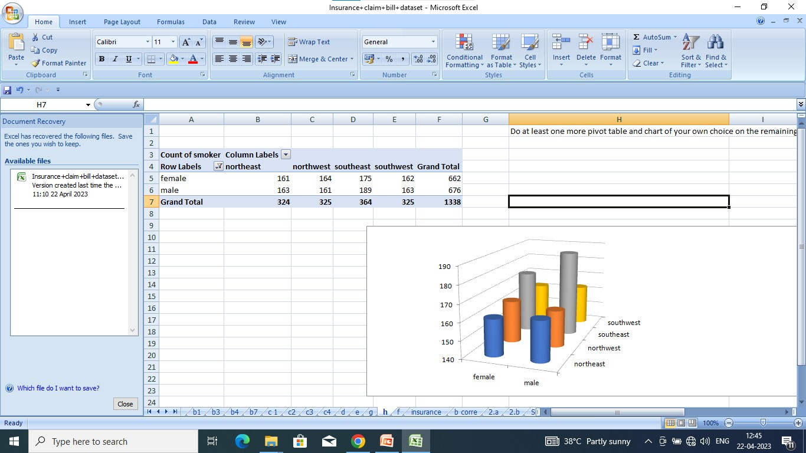

Slide 23
b.understanding from the patterns observed in point
Insights for histogram of age:
The frequencies vary widely across the different bins, ranging from as low as 23 to as high as 69. The highest frequencies appear to occur in the bins around 18, 23, 28, 32, 37, 41, 46, 51, and 55, which may suggest some sort of clustering or concentration of the data.
Insights for histogram of BMI:
The histogram shows that the frequencies increase gradually until around the mid-20s, and then sharply increase until around the mid-30s, after which they gradually decrease. This suggests that the variable may have some sort of bell-shaped or normal distribution, with the highest concentration of values around the mid-20s to mid-30s. There are also a few bins with low frequencies that are separated from the main group of bins, particularly around 16-18 and 42-45. These may represent outliers or values that are significantly different from the rest of the data.

Slide 24
interpretation for observations made in point (c)
The histogram for the children variable shows that the majority of the observations have either 0 or 1 children, with 574 and 324 observations respectively. There are also a considerable number of observations with 2 children (240) and 3 children (157), while the frequency of observations with 4 or more children gradually decreases.
There are 18 observations that fall into the "More" category, indicating that there are a few cases where the number of children is much larger than the average.
Overall, the histogram suggests that the data is skewed towards smaller numbers of children and that the distribution has a long tail towards larger numbers of children.

Slide 25
Insights for histogram of charges:
The histogram of charges variable shows the distribution of the medical charges paid by patients. The majority of patients (around 60%) had charges between 0 and 15,000 dollars, with the highest frequency occurring between 2,500 and 10,000 dollars.
There is a significant drop in the number of patients with charges over 15,000 dollars, with only a small percentage of patients having charges above 30,000 dollars. This suggests that most patients have relatively low charges, while a few patients have very high charges.
The distribution appears to be skewed to the right, with a long tail on the higher end, indicating that a few patients had exceptionally high charges compared to the majority of patients.

Slide 26
TASK 2.Edit the data as foll owing, to obtain dummy variables: a.replace male with 1 and feale with 0
Approach used: a.done replacing all the “Males” with “1” and “Females” with “0”, creating numerical entries for gender using find and replace option got used. .
B. Smoker: done Replacing all the “Smokers” with “1” and “Non-smokers” with “0” using find and replace option got used.
C. Region: for region also same thing has been done with numeric values but if else method got used for expected result.
Output:

Slide 27
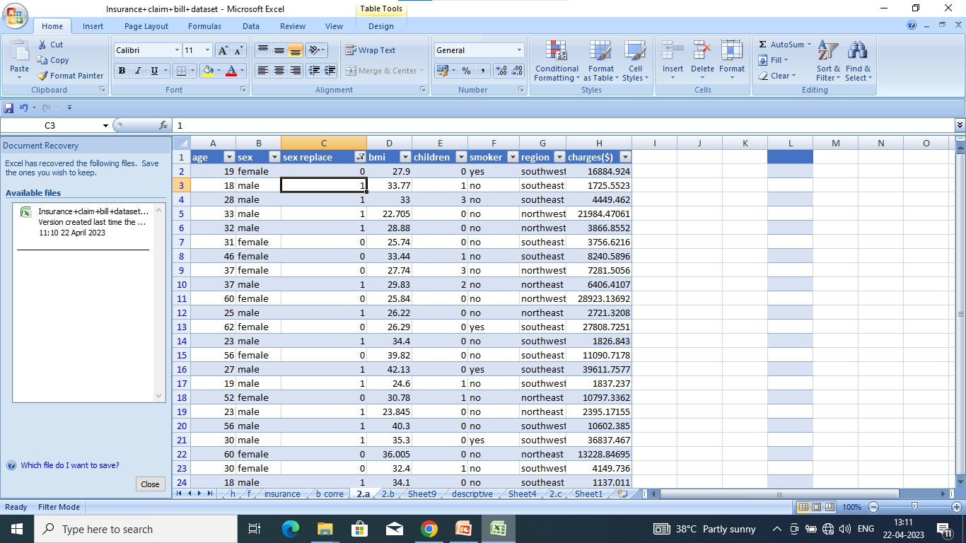
2.A.

Slide 28
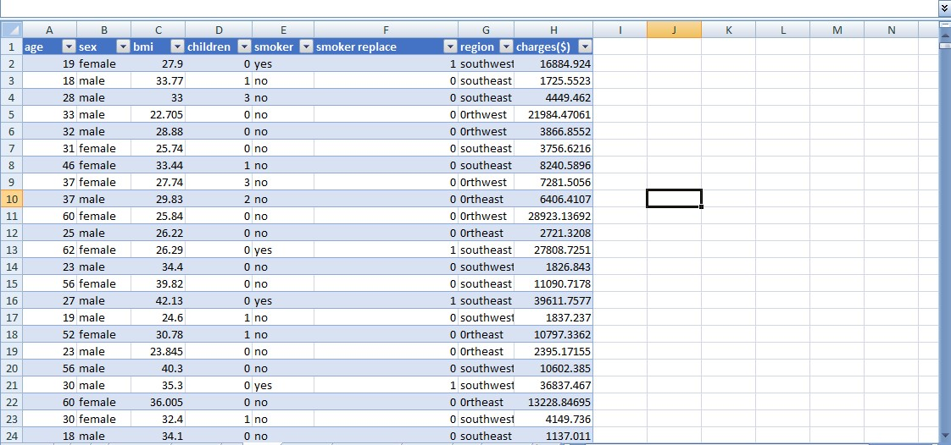
2.B

Slide 29
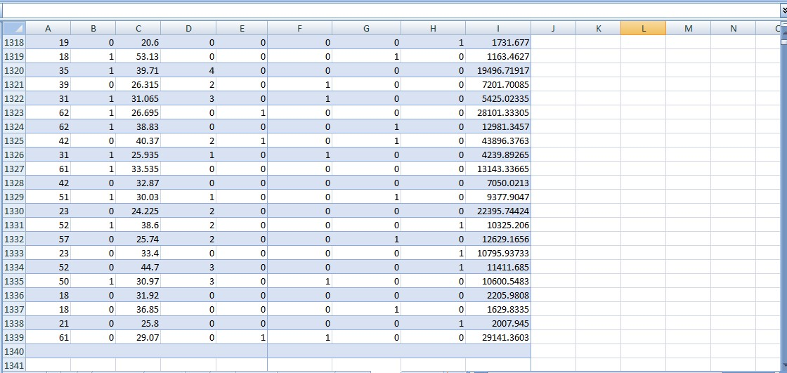
2.c

Slide 30
TASK 3.descriptive summary analysis for the edited data and regression analysis data
Interpretation for the regression analysis of the edited data:
﻿﻿Age: As the age increases, the insurance charges also increase
﻿BMI: As BMI increases, the insurance charges also increase. Children: The number of children leads to higher insurance charges.
﻿﻿Smoker: The increase in number of smokers leads to significantly higher insurance charges compared to non-smokers.
﻿Region: The Southeast and Southwest regions are associated with significantly lower insurance charges compared to the Northwest region
﻿﻿Sex: As sex increase, the insurance charges decrease. The variable "sex" does not significantly influence the insurance charges.

Slide 31
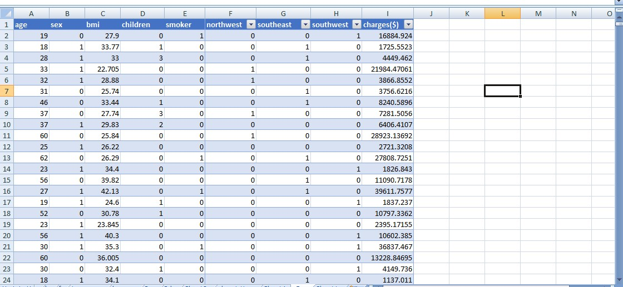

Slide 32
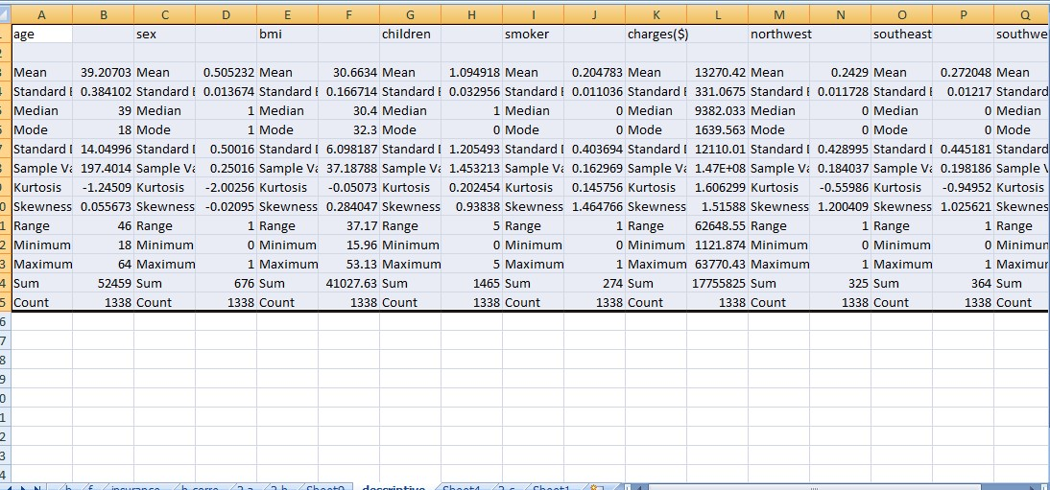

Slide 33
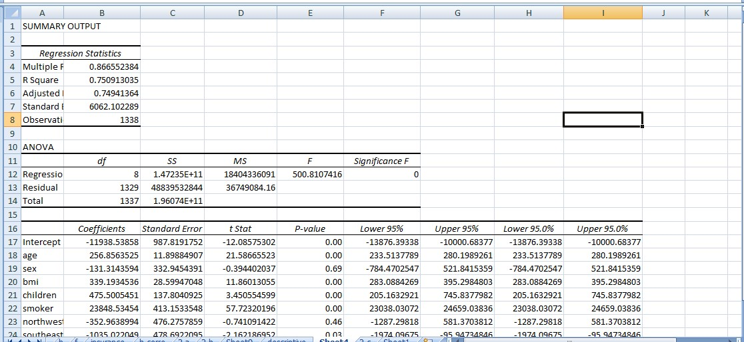

Slide 34
END

